Slide 1

Organizational Value
Workshop
May 4th, 2023
Notes:
We are going to discuss

Slide 2




Vision
To be the leading global CRO in dermatology and rheumatology
through innovative research and development
What we want to become
VALUES
What are our collective beliefs that describe the key behaviors to achieve our mission and vision
SMARTER TOGETHER
SEEK OUT INNOVATION
FRONTLINE FOCUS
DARE TO TAKE ACTION
Have a significant impact on health and quality of life by supporting the advancement of medical knowledge and the development of new therapies.
Who we are
What we value
MISSION
Innovaderm’s Employees
Notes:
Let’ me start the workshop by presenting you this outline.
As you see in my slide, employees are the ground of the house, the foundations of the company.
The mission which is to have a significant impact on health and quality of life by supporting the advancement of medical knowledge and the development of new therapies reflects who we are, what we value.
The values come out of the mission. The values are our collective beliefs that describe the key behaviors to achieve our mission and vision.
The vision is what we would like to be become in a near future.
All of this schema allows us to
1- offer valuable expertise and capabilities to develop new, more effective and safer treatments in partnership with sponsors,
2- Lead impact-based research initiatives, independent from financial outcomes.
3- Fund activities of the Montreal Dermatology Institute, whose mission is to advance knowledge of skin biology and pathology in order to help prevent, diagnose and treat skin diseases.
All of this would not be possible if we would not attract self-motivated professionals like you are.

Slide 3


How to promote an engaging culture?
Understanding
Integrating
Influencing
“We are here to inspire people to do the things that inspire them so that, together, each of us can change our world for the better.” – Simon Sinek
Notes:
This year, as Dr. Bisonnette announced, we have an organizational goal to promote an engaging culture. It is very important to have a shared, engaging culture. Let's think about this for a second...
Let's imagine that every individual in the company has their own way of doing things and their own methods, what we build will not be consistent and it will be a diluted culture. What do we want?
To have an engaging culture, we need to understand our values in concrete terms and live them in our daily activities.
If we don't understand them, we won't be able to integrate them and influence our colleagues. I really believe in «leading by example»
I know that values are not tangible, but my goal today is to help you make them more concrete and to support you through this workshop.

Slide 4



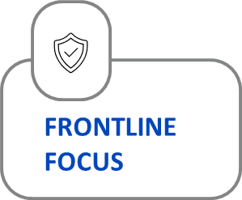


Objectives of the workshop
Impact
Alignment
Understand the front-line focus value and expected behaviors.
How can I be align with the value?
How can I live this value?
Newest
Relationships are a gift because they greatly
influence the exposure of our products and services.
Relationships are a gift because they greatly
influence the exposure of our products and services.
Notes:
There are two main goals today.
As employees, we need to understand the value Frontline focus.
And how I can align with that value and live it in my daily work.
Why the frontline focus ....
You're probably wondering why we start with this value? Well, the value of frontline focus is very important.
Because we wouldn't be a successful CRO if we didn't care about the needs of our sponsors, sites and patients.

Slide 5
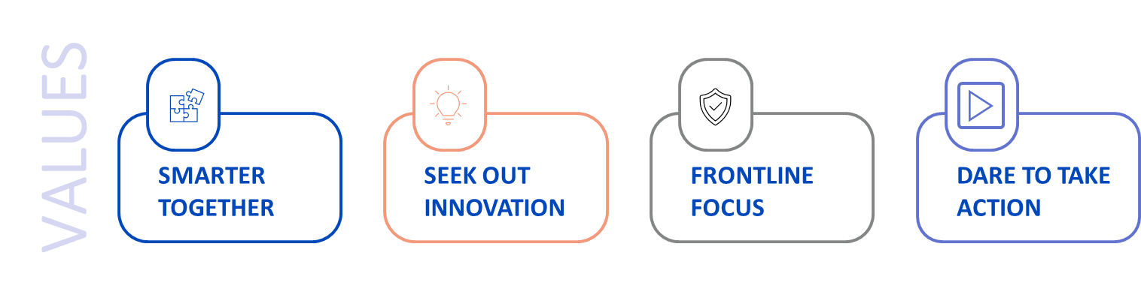
Exploring Innovaderm values
We work relentlessly for quality and client satisfaction on our 3 front lines: sponsors, research sites and research subjects. Whether or not we interact with the immediate front-line, we recognize that the sum of our contributions, no matter how big or small, is essential to our shared success.
Notes:
Let's take a look at what " Frontline Focus" is (Read the definition for the group)?
At the end of the day, we all work for the same company, with the same goal: to make an impact on patients with skin diseases.

Slide 6

Front-line focus
Behaviors
Gain and maintain an understanding of what is important for sponsors, research sites and research subjects
Focus on safety and data quality at research sites
Act as a partner in helping sponsors achieve their mission
Respectfully challenge requests when needed to better satisfy our clients’ true needs
Build trust over time by delivering on promises
Show interest in sponsor and research sites’ challenges and opportunities
Demonstrate expertise and superior service by anticipating needs
Notes:
The following are behaviors that are aligned with the FRONTLINE FOCUS value.

Slide 7

What is the client looking for?
Sponsors
Research sites
Research subjects
Discussion in subgroup
Groups of 4
Mini session - 15min
Round Table – 10 min
Notes:
We will work in sub-groups.
I'd like you to answer the question: what is the client looking for?
Think about the 3 front lines: sponsors / sites / topics.
Their needs may be different.
After about 15 minutes of breakout sessions, we will come back to the meeting room. A representative from each group will bring back the ideas generated in the breakout groups.
Be aware that there are no wrong answers. The goal is to share ideas together.

Slide 8

Quality and satisfaction
Sponsors
Research sites
Research subjects
OPEN DISCUSSION (10min)
How do I impact quality and client satisfaction in the work I do?
Notes:
Your answers lead us to the next activity, which focuses on quality and satisfaction. I would like you to ask yourself, What impact do you have on quality and customer satisfaction in your work?
To start the discussion, I'll give you an example of how I have an impact... (Give an example)
I won't name you in turn, but I expect everyone to share at least one impact.

Slide 9


Action plan
What action do I personally need to take to get closer to the front-line focus value?
Notes:
I'll give you two minutes to think about the question : What action do I personally need to take to get closer to the front-line focus value? (Manager give examples)
Do any of you want to share? This may be a lead-in to a solution, it does not have to be definitive, it doesn't have to be final.
Do you have any other questions

Slide 10
Conclusion
  Is the front-line focus value more concrete?
  Next steps:
  Add the action you would like to change in your day-to day in your annual plan in bob as an organizational value goal
  Second workshop planned in XXX
Notes:
If everyone does something, we will get there together.
I suggest that you add your action to get closer to the Frontline Focus value to the goals of your talent conversation in Ibob.
This will give you a concrete goal, even if you have already created one, so this is an opportunity to add a second one.

