Slide 1

Organizational Value
Workshop
June 2023
Notes:
We are going to discuss

Slide 2




Vision
To be the leading global CRO in dermatology and rheumatology
through innovative research and development
What we want to become
VALUES
What are our collective beliefs that describe the key behaviors to achieve our mission and vision
SMARTER TOGETHER
SEEK OUT INNOVATION
FRONTLINE FOCUS
DARE TO TAKE ACTION
Have a significant impact on health and quality of life by supporting the advancement of medical knowledge and the development of new therapies.
Who we are
What we value
MISSION
Innovaderm’s Employees
Notes:
Let’ me start the workshop by presenting you this outline.
As you see in my slide, employees are the ground of the house, the foundations of the company.
The mission which is to have a significant impact on health and quality of life by supporting the advancement of medical knowledge and the development of new therapies reflects who we are, what we value.
The values come out of the mission. The values are our collective beliefs that describe the key behaviors to achieve our mission and vision.
The vision is want we would like to be become in a near future.
All of this schema allows us to
1- offer valuable expertise and capabilities to develop new, more effective and safer treatments in partnership with sponsors,
2- Lead impact-based research initiatives, independent from financial outcomes.
3- Fund activities of the Montreal Dermatology Institute, whose mission is to advance knowledge of skin biology and pathology in order to help prevent, diagnose and treat skin diseases.
All of this would not be possible if we would not attract self-motivated professionals like you are.

Slide 3


How to promote an engaging culture?
Understanding
Integrating
Influencing
“We are here to inspire people to do the things that inspire them so that, together, each of us can change our world for the better.” – Simon Sinek
Notes:
This year, as Dr. Bisonnette announced, we have an organizational goal to promote an engaging culture. It is very important to have a shared, engaging culture. Let's think about this for a second...
Let's imagine that every individual in the company has their own way of doing things and their own methods, what we build will not be consistent and it will be a diluted culture. What do we want?
To have an engaging culture, we need to understand our values in concrete terms and live them in our daily activities.
If we don't understand them, we won't be able to integrate them and influence our colleagues. I really believe in «leading by example»
I know that values are not tangible, but my goal today is to help you make them more concrete and to support you through this workshop.

Slide 4






Objectives of the workshop
Impact
Alignment
Understand seek out innovation value and expected behaviors.
How can I be align with the value?
How can I live this value?
Newest
Relationships are a gift because they greatly
influence the exposure of our products and services.
Relationships are a gift because they greatly
influence the exposure of our products and services.
SEEK OUT INNOVATION
Notes:
There are two main goals today.
As employees, we need to understand the value Frontline focus.
And how I can align with that value and live it in my daily work.
Why the frontline focus ....
You're probably wondering why we start with this value? Well, the value of frontline focus is very important.
Because we wouldn't be a successful CRO if we didn't care about the needs of our sponsors, sites and patients.

Slide 5
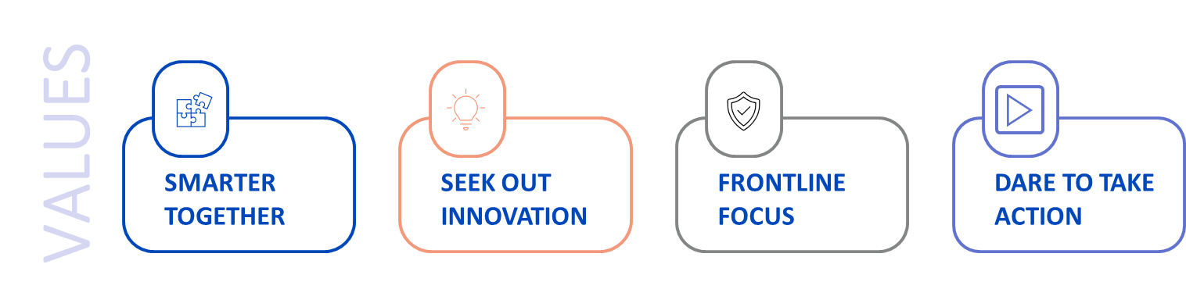
Exploring Innovaderm values
We are creative and solution-oriented. We actively look for solutions and implement them to add value in everything we do.
Notes:
Let's take a look at what " Frontline Focus" is (Read the definition for the group)?
At the end of the day, we all work for the same company, with the same goal: to make an impact on patients with skin diseases.

Slide 6

Seek out Innovation
Behaviors
Actively seek opportunities for improvement
Explore and implement new ideas
Support the best ideas no matter who brings them forward
Generate new ideas and opportunities
Keep abreast of industry best practices and suggest novel approaches
Be at the forefront of the latest technologies, services and developments, and leverage them for innovation
Notes:
The following are behaviors that are aligned with the Seek Out Innovation value.

Slide 7

Why is innovation important?
Discussion in subgroup
Groups of 4
Mini session - 15min
Round Table – 10 min
Notes:
We will work in sub-groups.
I'd like you to answer the question: Why is innovation important?
Innovation helps you anticipate market changes more quickly to take advantage of opportunities, acting instead of reacting to turbulence.
Think about our sponsors, our sites and our subjects.
Why do we need to innovate on this three level?
After about 15 minutes of breakout sessions, we will come back to the meeting room. A representative from each group will bring back the ideas generated in the breakout groups.
Be aware that there are no wrong answers. The goal is to share ideas together.

Slide 8

LET’S KILL THE COMPANY!
OPEN DISCUSSION (10min)
List what could kill the company in terms of actions, attitudes and behaviors.
Notes:
Examples of what could kill the company
Retaining knowledge
Disengage teams from their responsibilities
Limit social and human communication
To be sure of killing a company, bet on the fear of change
Do not communicate, do not take any steps to make yourself known as a company
To start the discussion, I'll give you an example of how I could kill the company... (Give an example)
I won't name you in turn, but I expect everyone to share at least one impact.

Slide 9


Action plan
In relation to the behaviors arising from the value presented. Are you able to adopt them? Which ones have you mastered and which ones do you need to improve?
Notes:
I'll give you two minutes to think about the question : What action do I personally need to take to get closer to the seek out innovation value? (Manager give examples)
Do any of you want to share? This may be a lead-in to a solution, it does not have to be definitive, it doesn't have to be final.
Do you have any other questions

Slide 10
Conclusion
  Is Seek Out Innovation value more concrete?
  Next steps:
  Add the action you would like to change in your day-to day in your annual plan in bob as an organizational value goal
  Second workshop planned in September
Notes:
If everyone does something, we will get there together.
I suggest that you add your action to get closer to seek out innovation value to the goals of your talent conversation in Ibob.
This will give you a concrete goal, even if you have already created one, so this is an opportunity to add a second one.

